Slide 1
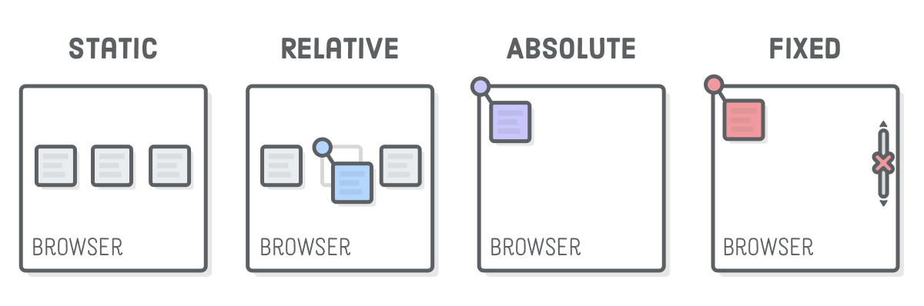
POSITION & FLOAT
SoftUni Team
Technical Trainers
Software University
https://softuni.bg

Slide 2
Table of Contents
Float property
Clear property
Position: static, relative, absolute, fixed and sticky
Positioning Properties
Z-index

Slide 3
Have a Question?
sli.do
#HTML-CSS

Slide 4
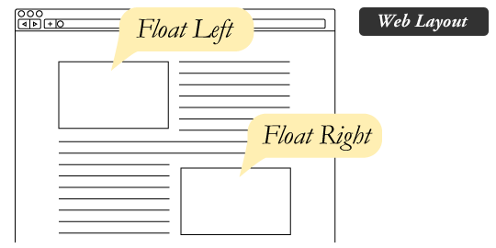
Float Property

Slide 5
What is Float?
CSS float is a property that forces any element to float (right, left, none, inherit) inside its parent body with the rest of the element to wrap around it
The element is removed from the normal flow of the page, though still remaining a part of the flow

Slide 6
Float Property
Float values:
float : right; - floats the element to right of it's container
float : left; - floats the element to left of it's container
float : none; - it will restrict the element to float
float : initial; - the element remains to it's default position
float : inherit; - enables the element to inherit the property from its parent element

Slide 7
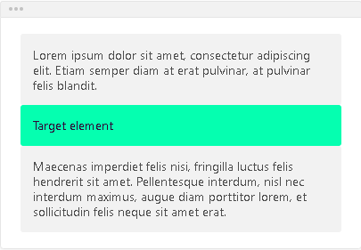
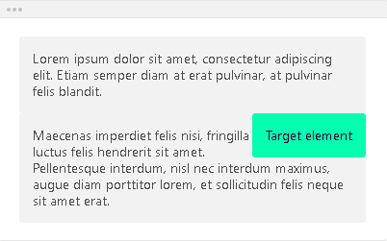
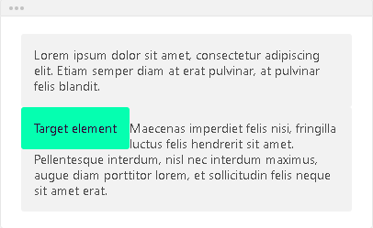
Float Property - Example
float: none;
float: right;
float: left;

Slide 8

Floating multiple Elements
<body>
<img class="image" src="girl.png"/>
<img class="image" src="music.png"/>
<img class="image" src="mug.png"/>
<img class="image" src="nature.png"/>
</body>
.image {
float: left;
width: 150px;
height: 100px;
margin: 5px;
}

Slide 9
Float Property
As float implies the use of the block layout, it modifies the computed value of the display values, in some cases:
Specified value Computed value
inline block
inline-block block

Slide 10
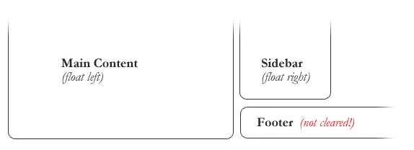
Clearing the Float
Float’s sister property is clear
An element that has the clear property set on it will not move up adjacent to the float like the float desires but will move itself down past the float
General rule for dealing with Float
When you add float, always make sure that it is cleared properly. At the time of adding it.

Slide 11
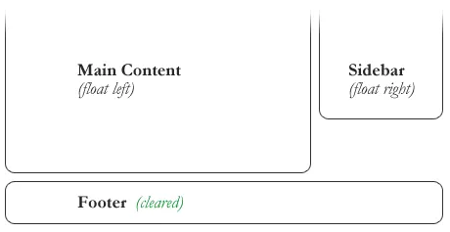
Clearing the Float
In the above example, the sidebar is floated to the right and is shorter than the main content area
The footer then is required to jump up into that available space as is required by the float
To fix this problem, the footer can be cleared to ensure it stays beneath both floated columns
#footer {
clear: both;
}

Slide 12
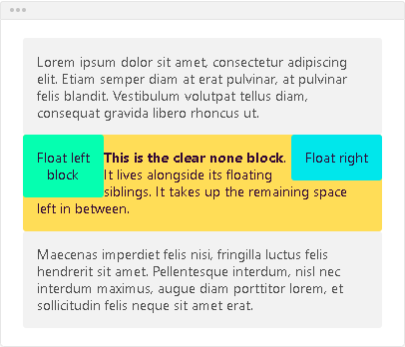
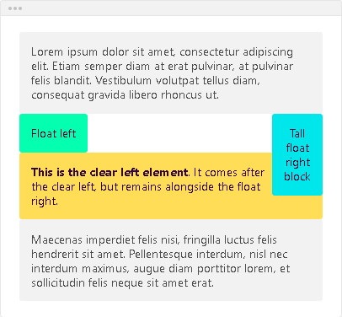
Clear
The clear property has four values:
clear: none;
clear: left;

Slide 13
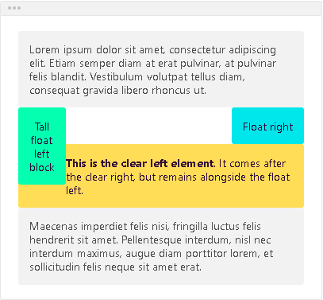
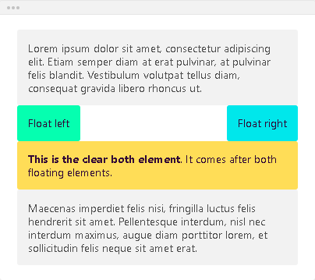
Clear
clear: right;
clear: both;

Slide 14
Position

Slide 15
Position
The position property specifies the type of positioning method used for an element
Static
Relative
Absolute
Fixed
Sticky

Slide 16
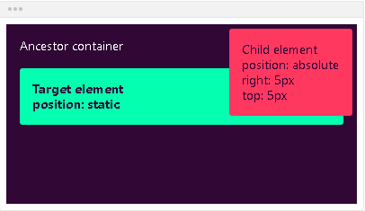
Position Static
Static – the default state of every element. It just means ''put the element into its normal position in the document layout flow''
Also, it will not react to the following properties: top, bottom, left, right, z-index
[selector] {
position: static;
}

Slide 17
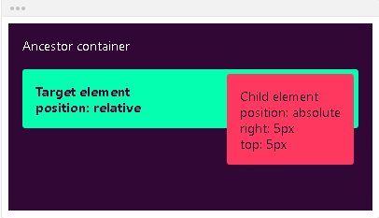
Position Relative
Relative – very similar to static positioning, except that once the positioned element has taken its place, you can then modify its final position with the positional properties – left, right, top, bottom, z-index
It also makes the element positioned: it will act as anchor point for the absolutely positioned block
[selector] {
position: relative;
}

Slide 18
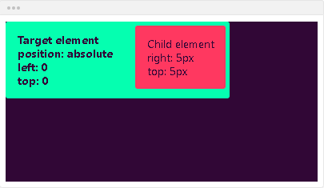
Position Absolute
Absolute – the element will not remain in the natural flow of the page. It will react to the positional properties
It will positon itself according to the closest positioned ancestor
Because it’s positioned, it will act as an anchor point for the absolutely positioned block
[selector] {
position: absolute;
}

Slide 19
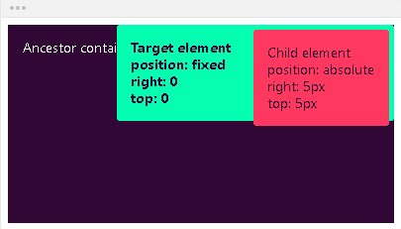
Position Fixed
Fixed – the element will not remain in the natural flow of the page. It will react to the positional properties
It will position itself according to the viewport
Because it’s positioned, it will act as an anchor point for the absolutely positioned block
[selector] {
position: fixed;
}

Slide 20
Position Sticky
Sticky – the element is positioned based on the user’s scroll position
A sticky element toggles between relative and fixed, depending on the scroll position
It is positioned relative until a given offset position is met in the viewport – then it ''sticks'' in place (like position: fixed)

Slide 21
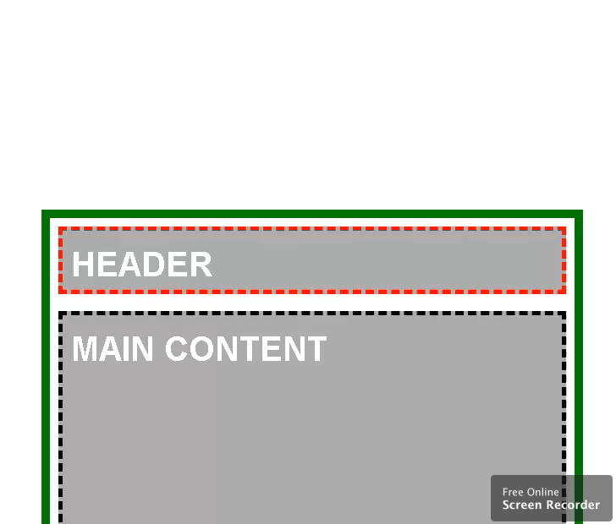
Position Sticky - Example
.main-container {
max-width: 600px;
margin: 0 auto;
border:10px solid green;
padding:10px;
margin-top:40px;
}
.main-header,
.main-content,
.main-footer {
padding: 10px;
background:#aaa;
border: 5px dashed #000;
margin: 20px 0;
}
<main class="main-container">
<header class="main-header">HEADER</header>
<div class="main-content">MAIN CONTENT</div>
<footer class="main-footer">FOOTER</footer>
</main>
.main-content{
min-height:1000px;
} .main-header{
height: 50px;
border-color: red;
position: sticky;
top: 0;
}

Slide 22
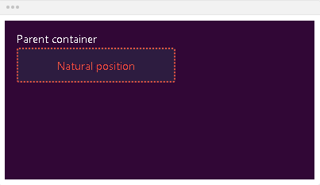
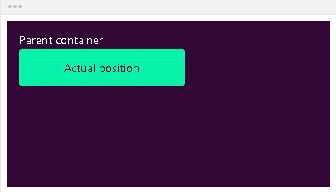
Bottom
Bottom – defines the position of the element according to its bottom edge
bottom: auto; - the element will remain in its natural position

Slide 23
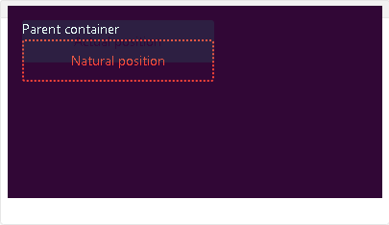
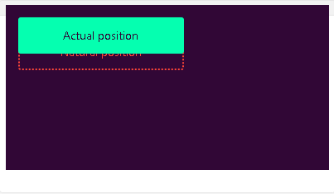
Bottom
bottom: 20px;
If the element is in position relative, the element will move upwards by the amount defined by the bottom value

Slide 24
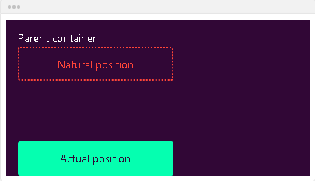
Bottom
bottom: 0;
If the element is in position absolute, the element will position itself from the bottom of the first positioned ancestor

Slide 25
Left
Left – defines the position of the element according to its left edge
left: auto; - the element will remain in its natural position

Slide 26
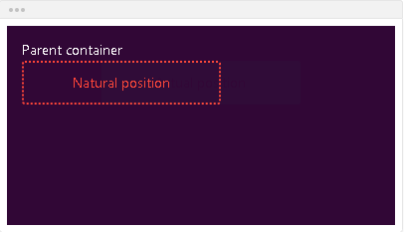
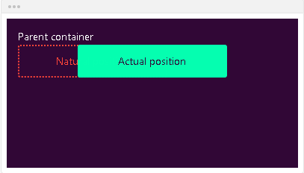
Left
left: 80px; - if the element is in position relative, the element will move left by the amount defined by the left value

Slide 27
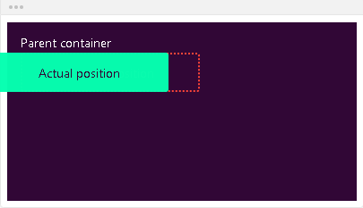
Left
left: -20px; - if the element is in position absolute, the element will position itself from the left of the first positioned ancestor

Slide 28
Right
Right – defines the position of the element according to its right edge
right: auto; - the element will remain in its natural position

Slide 29
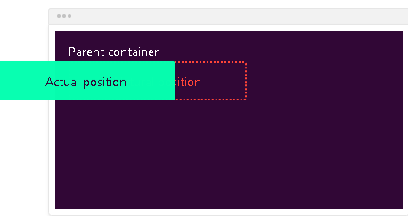
Right
right: 80px; - if the element is in position relative, the element will move right by the amount defined by the right value

Slide 30
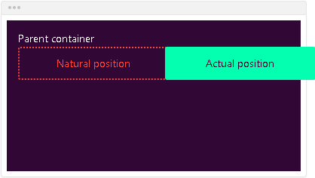
Right
right: -20px; - If the element is in position absolute, the element will position itself from the right of the first positioned ancestor

Slide 31
Top
Top – defines the position of the element according to its top edge
top: auto; - the element will remain in its natural position

Slide 32
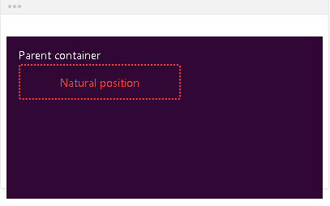
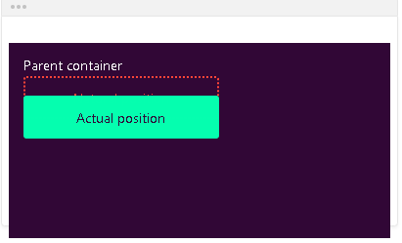
Top
top: 20px; - If the element is in position relative, the element will move downwards by the amount defined by the top value

Slide 33
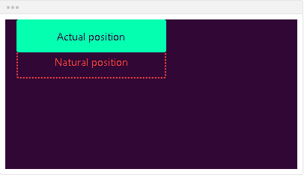
Top
top: 0; - If the element is in position absolute, the element will position itself from the top of the first positioned ancestor

Slide 34
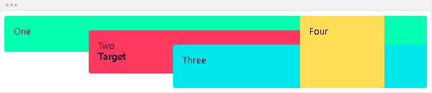
Z-index
Defines the order of the elements on the z-axis. It only works on positioned elements (anything apart from static)
z-index: auto;
The order is defined by the order in the HTML code:
First in the code = behind
Last in the code = in front

Slide 35
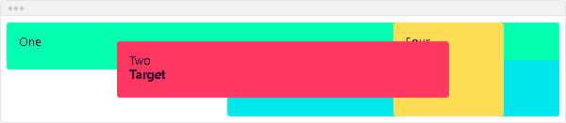
Z-index
z-index: 1;
The z-index value is relative to the other ones. The target element is move in front of its siblings

Slide 36
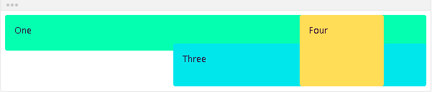
Z-index
z-index: -1;
You can use negative values. The target element is move in behind its siblings

Slide 37

Summary
What is a float?
How to float elements?
How to clear float?
Positioning properties
How to work with z-index?
…
…
…

Slide 38












SoftUni Diamond Partners

Slide 39




SoftUni Organizational Partners

Slide 40
Questions?
Notes:
40

Slide 41

License
This course (slides, examples, demos, exercises, homework, documents, videos and other assets) is copyrighted content
Unauthorized copy, reproduction or use is illegal
© SoftUni – https://softuni.org
© Software University – https://softuni.bg
Notes:
41

Slide 42
Trainings @ Software University (SoftUni)
Software University – High-Quality Education, Profession and Job for Software Developers
softuni.bg, softuni.org
Software University Foundation
softuni.foundation
Software University @ Facebook
facebook.com/SoftwareUniversity
Software University Forums
forum.softuni.bg
Notes:
42

